Slide 1

No Training Hurdles: Fast Training-Agnostic Attacks to Infer Your Typing
Song Fang*, Ian Markwood†, Yao Liu†,
Shangqing Zhao†, Zhuo Lu†, Haojin Zhu‡
*University of Oklahoma
†University of South Florida
‡Shanghai Jiaotong University

Slide 2


Background
Typing via a keyboard plays a very important role in our daily life.
What are you typing?
Hacker

Slide 3



Existing Non-invasive Attacks
Malware
NOT REQUIRED
Software or hardware based keylogger
General principle: pressing a key causes subtle environmental impacts unique to that key

Slide 4





Example Attacks
Vibration pattern
Environmental change
Acoustic feature
Wireless distortion
Training Phase
Trained model
Attack Phase
Checking training data
Unknown
disturbances
Keystrokes

Slide 5
Why Is Training A Hurdle
A user may change typing behaviors
No physical control of keyboard
Require pressed key knowledge

Slide 6
Statistical Methods
Frequency analysis: analyzing the frequencies of observed disturbances
A large amount of text

Slide 7

Question: Is it possible to develop a non-invasive keystroke eavesdropping within a shorter time?
Probabilistic Statistics
Self-contained structures of words
Type Disturbances
sense

Slide 8
Wireless Signal Based Attacks
Advantages:
  Ubiquitous deployment of wireless infrastructures
  Radio signal nature of invisibility
  Elimination of the line-of-sight requirement
CSI (channel state information) quantifies the disturbances
Public
X(f, t)
Y(f, t)

Slide 9
Outline
Motivation
Attack Design
Experiment Results
Conclusion

Slide 10

System Overview
Signal
CSI time series
Channel estimation
Noise removal
Pre-processing
Reduction
CSI word group generation
Segmentation
CSI samples
Dictionary demodulation
Alphabet matching
Keystrokes
A CSI sample refers to an individual segment corresponding to the action of pressing a key.

Slide 11
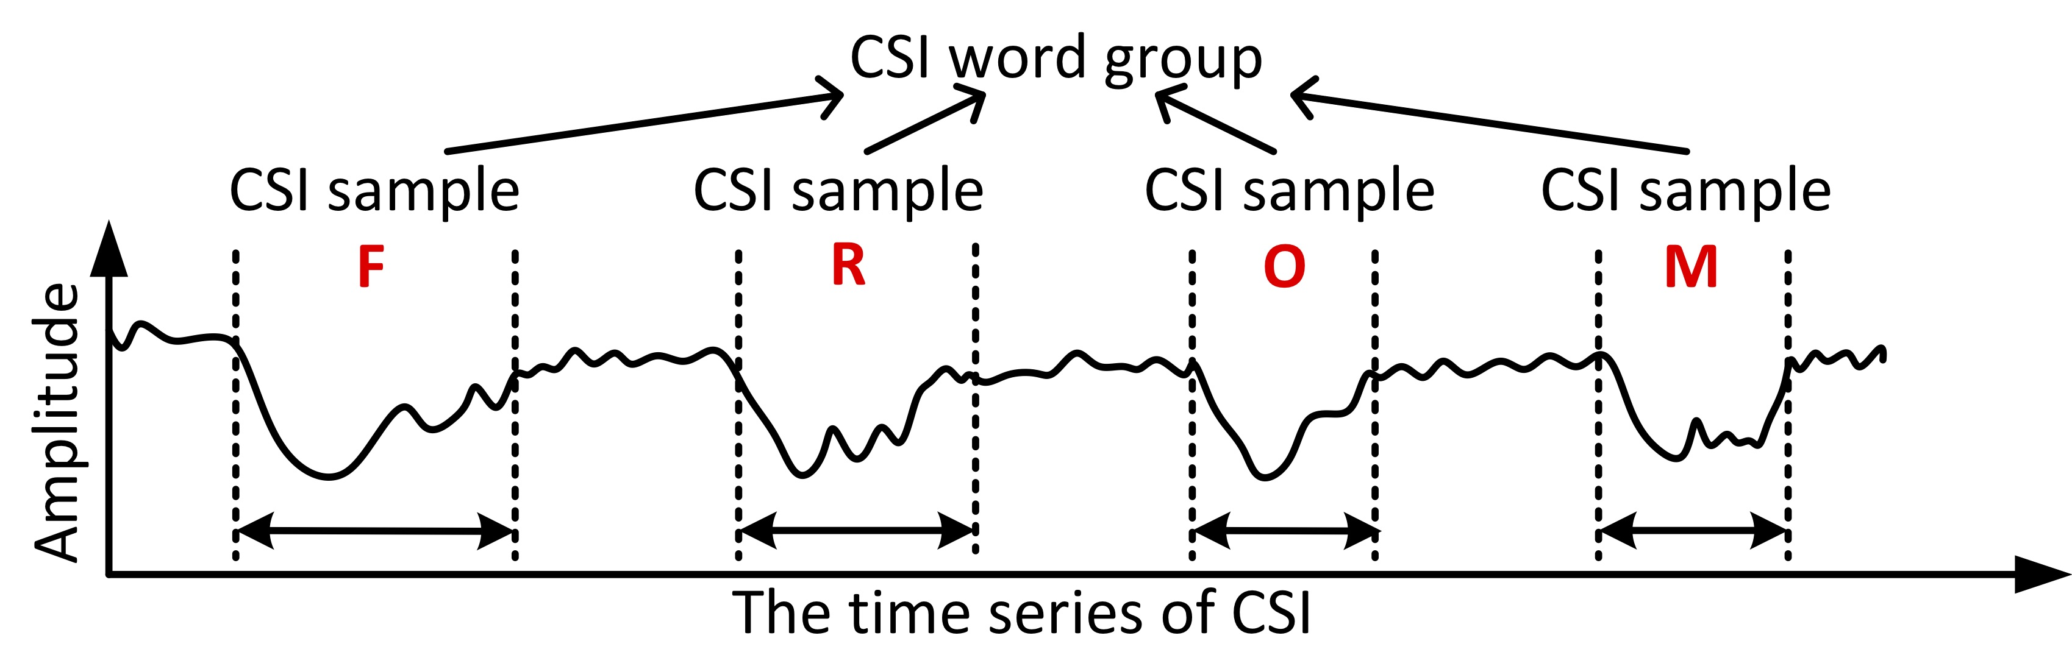
CSI Word Group Generation
CSI samples
Classification
Sorting
Word segmentation
CSI word groups
A CSI word group refers to the a group of CSI samples comprising each typed word.

Slide 12
Classification
Sorting
Word segmentation
· · ·
Set 1
Similarity calculation
CSI samples
Set 2
· · ·

Slide 13

Classification
Sorting
Word segmentation
Set 1
Set 2
Set i
Set N
· · ·
· · ·
Sort based on the size
· · ·
· · ·
· · ·

Slide 14
Classification
Sorting
Word segmentation
time
……
……
CSI word group
……
Dictionary demodulation
Space-associated
/ / /···
Non-space-associated

Slide 15
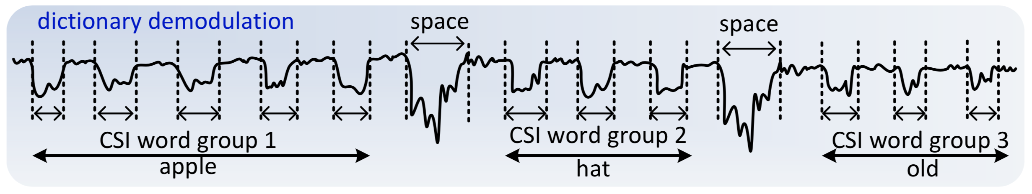
Dictionary Demodulation (DD)
DD
Feature Extraction
Joint Demodulation
CSI word groups
English words
Error Tolerance
(Eg., )
Non-Alphabetical Impact

Slide 16
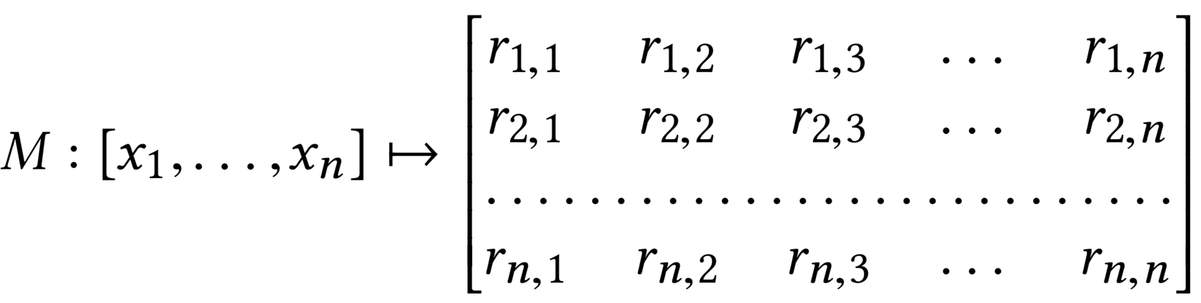
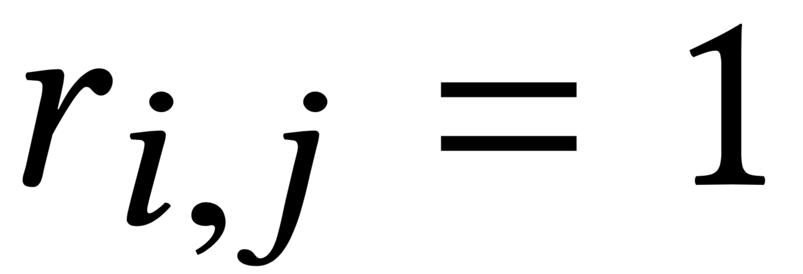
Feature Extraction
Length L: number of constituent letters
Repetition {L, (t₁, …, t_{r})}:
  r is the number of distinct letters that repeat,
  t_{i} denotes how many times the corresponding letter repeats
Inter-Element Relationship Matrix M
if x_{i} and x_{j} are same or similar

Slide 17
Feature Extraction
Dictionary: Top 1,500 most frequently used word list^{[1]}
· · ·
Set 1
Selected feature
English words
Set 2
Length OR
· · ·
Repetition OR
Relationship Matrix
[1] Mark Davies. “Word frequency data from the Corpus of Contemporary American English (COCA),” http://www.wordfrequency.info/free.asp.

Slide 18
Feature Extraction
-- number of sets obtained
Uniqueness rate
-- number of consider words
Better partitioning (distinguishability)
 | Uniqueness rate | Average set cardinality
Length | 0.009 | 107
Repetition | 0.042 | 24
Relationship matrix | 0.225 | 4

Slide 19
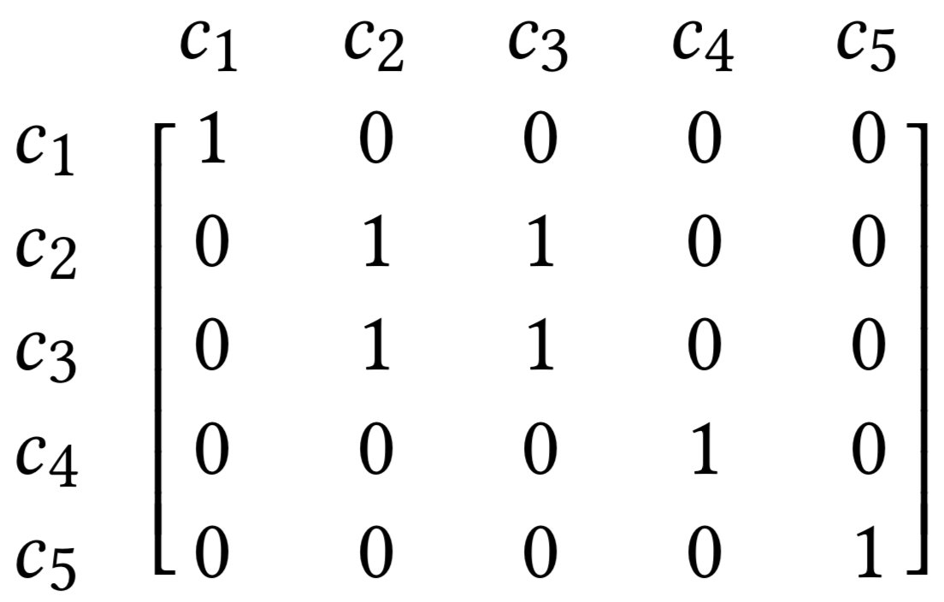
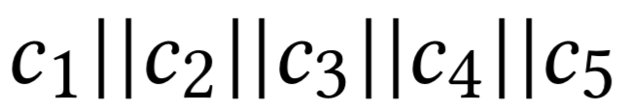
Joint Demodulation
Example:
A dictionary W={‘among’, ‘apple’, ‘are’, ‘hat’, ‘honey’, ‘hope’, ‘old’, ‘offer’, ‘pen’}.
Type in two words: “apple” and “pen”
1)
R₁:
2) compute the relationship matrix for each word in W, and compare each with R₁
Candidates: “apple” and “offer”

Slide 20

Joint Demodulation
3)
Candidates: {“hat”, “old”, “are”, “pen”}
4)
||
R_{new}
5) Candidates T of the two-word sequence,
6) Generate the relationship matrix for each new candidate in T and compare it with R_{new}
{“apple||hat”, “apple||old”, “apple||are”, “apple||pen”,
“offer||hat”, “offer||old”, “offer||are”, “offer||pen”}
Final result: “apple||pen”

Slide 21
Joint Demodulation
Input:
  m CSI word groups S = {S₁, S₂, …, S_{m}};
  dictionary with q words W = {W₁, W₂, …, W_{q}}
Output:
  a corresponding phrase of m words
Observation:
  each CSI word group => multiple candidate words
  each candidate => <CSI sample, letter> mapping info

Slide 22
Joint Demodulation
Step 1: find initial candidate words for each CSI word group
R_{CSI word group}
Compare
R_{each word}
=> match, add the word as a candidate;
no match, add the CSI word group to the “undemodulated set” U

Slide 23
Joint Demodulation
Step 2 (iteratively):
T_{i} : concatenation of the first i-1 demodulated CSI word groups; candidates for T_{i} are {T_{i1} , T_{i2} ,…, T_{ip} }
S_{i} : the i-th CSI word group;
candidates for S_{i} are {S_{i1} , S_{i2} ,…, S_{iq} } (by step 1)
Find new candidates for concatenated CSI word groups
R
T_{i}||S_{I}
Compare
R
T_{ij}||S_{ik} (1<=j<=p, 1<=k<=q)
=> match, add T_{ij}||S_{ik} as a candidate for T_{i+1} ;
no match, add S_{i} to U and skip to S_{i+1}

Slide 24
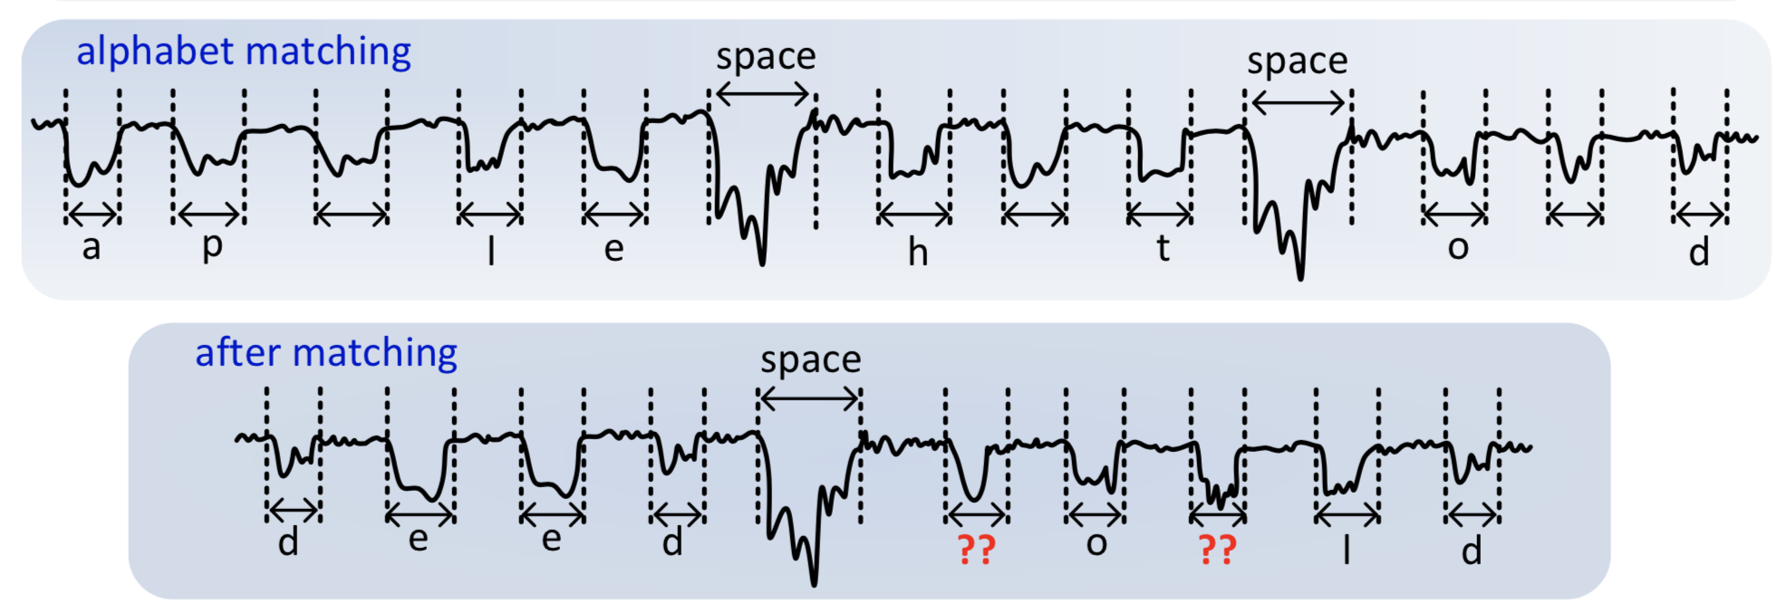
Joint Demodulation
Alphabet matching: the mapping can be applied to the remaining CSI word groups and those in U
Example: the user types “deed” || “would” after the mapping is established;

Slide 25
Error/Non-Alphabetical Characters Tolerance
Abnormal situations:
  CSI classification errors
  Typos/Non-Alphabetical Characters
X
A CSI sample for the letter
Set of CSI samples for the letter
Have no candidates
Match with invalid words
Consequence
Add the CSI word group to the set U
Cascading discovery failures

Slide 26
Outline
Motivation
Attack Design
Experiment Results
Conclusion

Slide 27
Experiment Results
Attack system:
  a wireless transmitter + a receiver
  (each is a USRP connected with a PC)
  the channel estimation algorithm runs at the receiver to extract the CSI for key inference.
  dictionary: Top 1,500 most frequently used word list
Target user:
  a desktop computer with a Dell SK-8115 USB wired standard keyboard

Slide 28
Example Recovery Process
Randomly select 5 sentences from the representative English sentences in the Harvard sentences^{[2]}.
[2] IEEE Subcommittee on Subjective Measurements. “IEEE Recommended Practice for Speech Quality Measurements,” IEEE Transactions on Audio and Electroacoustics, vol. 17, no. 3 (Sep 1969), pp. 227–246.

Slide 29
Eavesdropping Accuracy
# of successfully recovered words
Word recover ratio=
total # of input words
Single article recovery (Type a piece of CNN news)

Slide 30
Impact of CSI Sample Classification Errors
We artificially introduce errors into the groupings.

Slide 31
Overall Recovery Accuracy
L_{WRR>x} denotes the required number of typed words from each article to satisfy the ratio x.

Slide 32
Time Complexity Analysis
The comparison of relationship matrices is the dominant part of the demodulation phase.

Slide 33
Password Entropy Reduction
The higher the entropy, the more the randomness
2012 Yahoo! Voices hack^{[3]}: 342,508 passwords: 98.42% of passwords are 12 characters or fewer
[3] 2012 Yahoo! Voices hack. https://en.wikipedia.org/wiki/2012_Yahoo!_Voices_hack

Slide 34
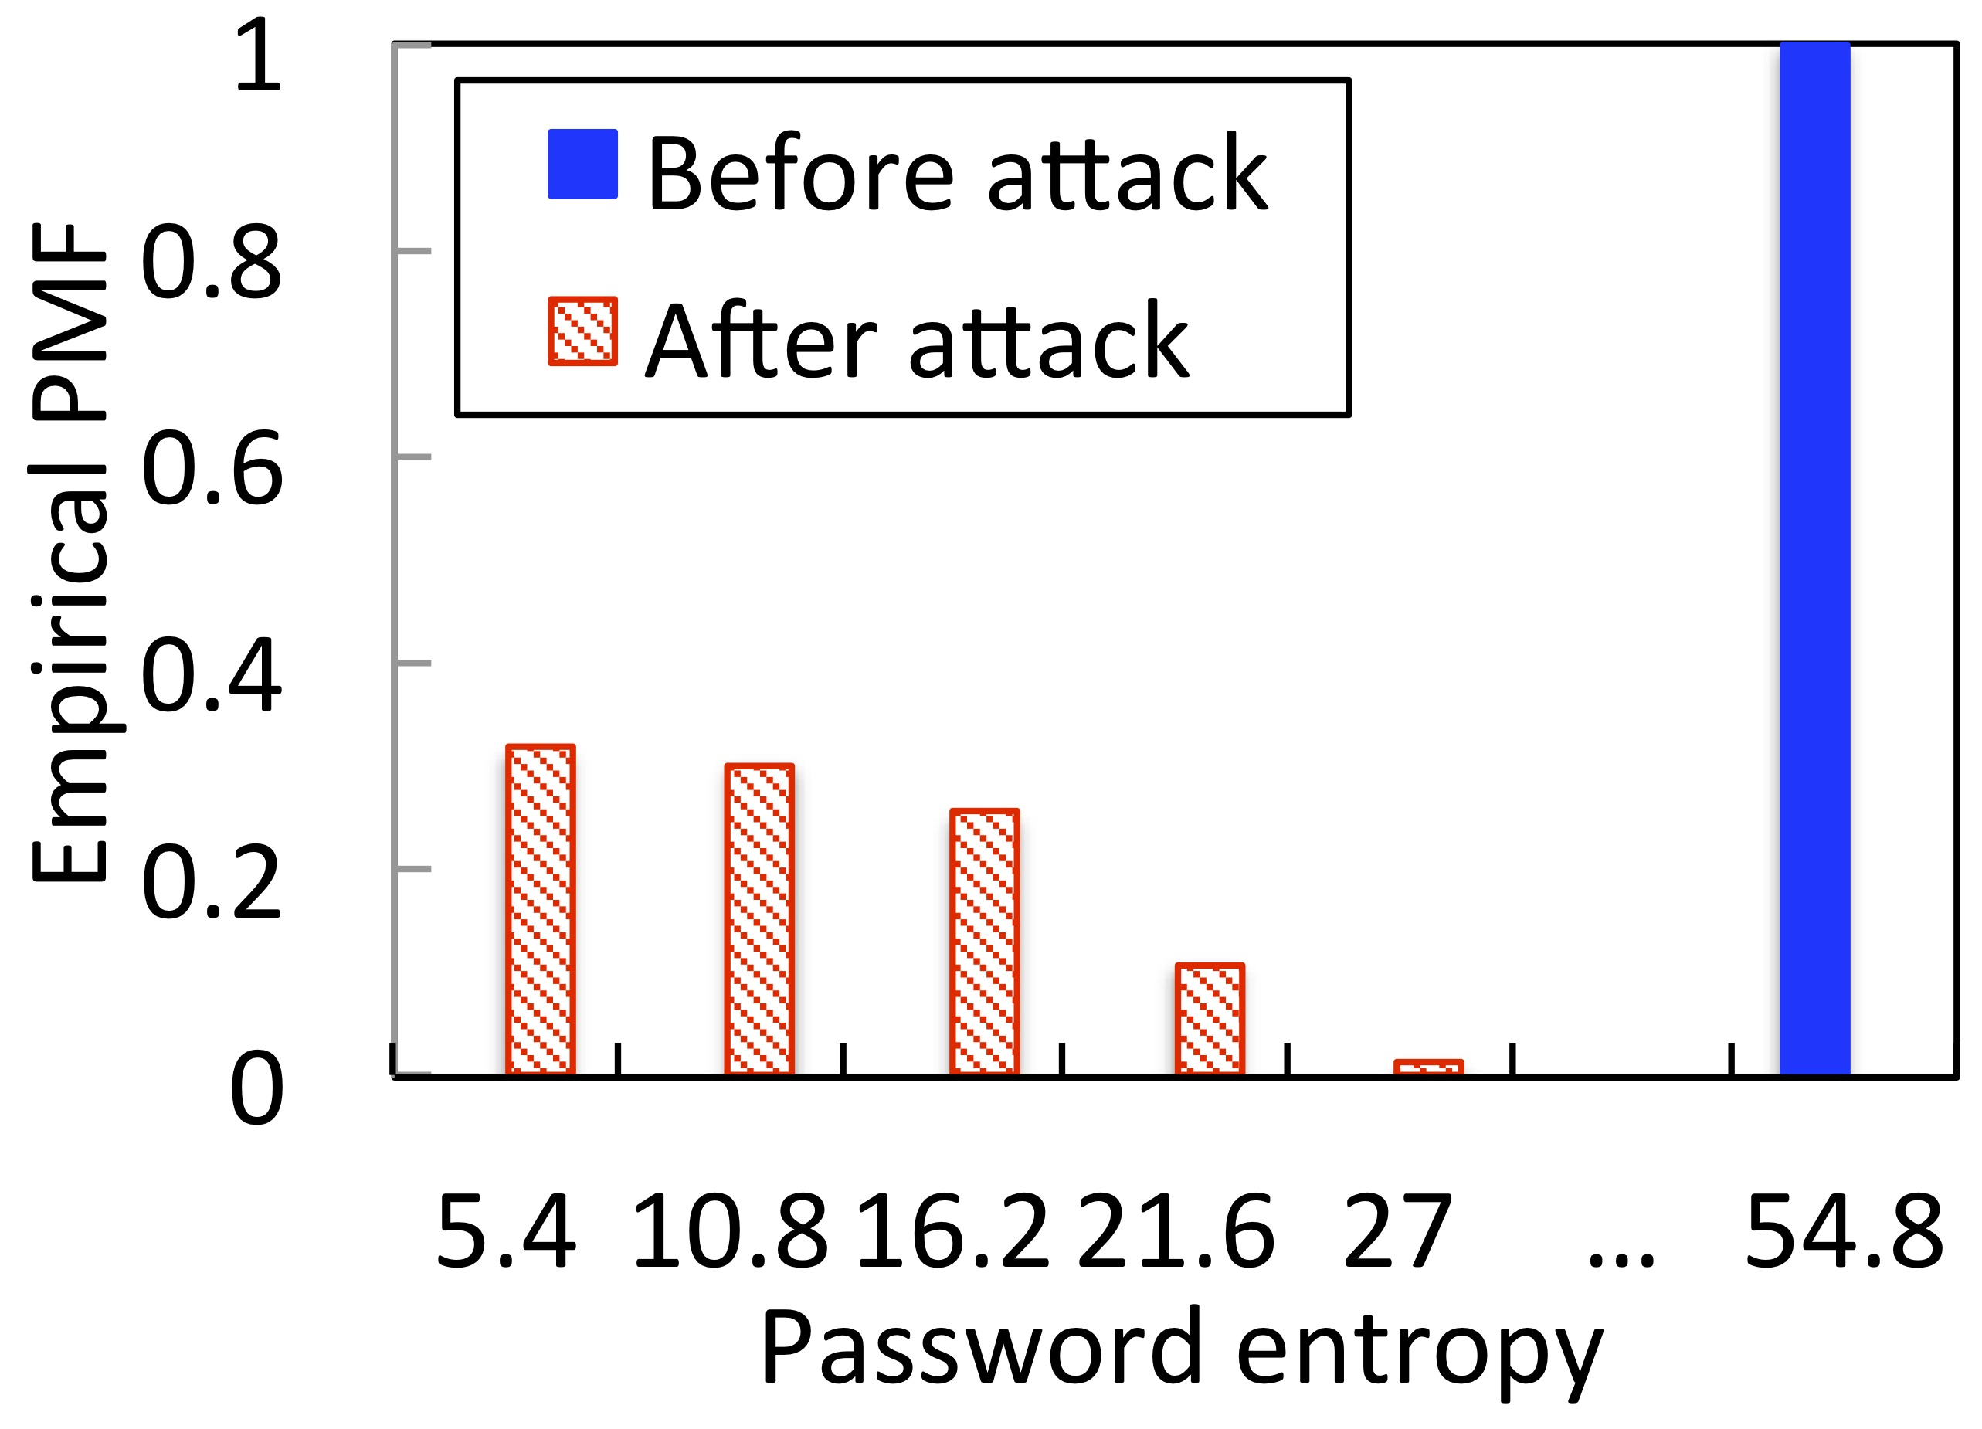
Password Entropy Reduction (Cont’d)
Breaking a 9-character password is reduced to guessing 1-5 non-letter characters.

Slide 35
Outline
Motivation
Attack Design
Experiment Results
Conclusion

Slide 36
Conclusion
Identify a new type of keystroke eavesdropping attack bypassing the training requirement
Create a joint demodulation algorithm to establish the mapping between a letter and a CSI sample
Implement this attack on software-defined radio platforms and conduct a suite of experiments to validate its impact

Slide 37
Thank you!
Any questions?

