Slide 1

Stateful Inter-Packet Signal Processing for Wireless Networking
Shangqing Zhao ^{ꝉ}, Zhengping Luo ^{ꝉ}, Zhuo Lu ^{ꝉ}, Xiang Lu ^{ǂ}, Yao Liu ^{ꝉ}
^{ꝉ} University of South Florida
^{ǂ} Chinese Academy of Sciences (CAS), and University of CAS

Slide 2
Outline
Background
Motivation
STAPLE
  Architecture
  State configuration
Implementation and experiments
  Experimental setups
  Evaluation results
Summary

Slide 3
Modern Wireless Communication
Pad
AP
Laptop
Smart Phone

Slide 4

Modern Wireless Communication
Preamble
Header
Data
Packet

Slide 5
Modern Wireless Communication
Preamble
Header
Data
  Known to the public (training sequence)
  Used for energy detection, timing/frequency synchronization, channel estimation…

Slide 6
Modern Wireless Communication
Preamble
Header
Data
  Specify the packet information for different layers
    PHY: packet length, data rete …
    MAC: frame type, source and destination address …

Slide 7
Modern Wireless Communication
Preamble
Header
Data
  User’s actual data

Slide 8
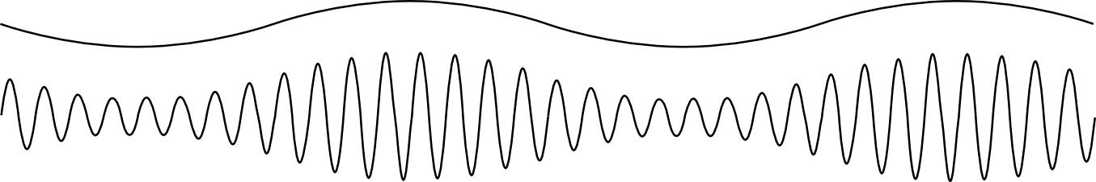
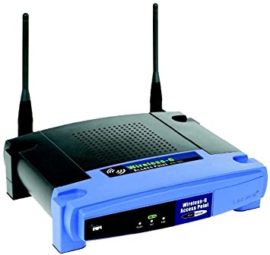
Modern Wireless Communication
Wireless Receiver

Slide 9
Modern Wireless Communication
Wireless Receiver
Signal processing
Signal decoding
Preamble
Synchronization
Channel estimation
Equalization

Slide 10
Modern Wireless Communication
Wireless Receiver
Signal processing
Signal decoding
Header
Demodulating -
Decoding -

Slide 11
Modern Wireless Communication
Wireless Receiver
101101…
Signal processing
Signal decoding

Slide 12
Modern Wireless Communication
Wireless Receiver
Packet 1
Packet 2
Signal processing
Signal decoding
Rethink this process and leverage common information across packets to improve signal processing
Independent for each packet arrival
Fact: wireless channel is random, and frequency offset and CSI are time-varying

Slide 13
Motivation
Examples:
Case 1: a station (STA) only receives data from a certain access point (AP)
common information:
  Source address
  Destination address
AP
STA

Slide 14


Motivation
Examples:
Case 2: use cellphone to watch a movie online
common information:
  Packet length
  Data rate

Slide 15
Motivation
Question:
Does the common information (e.g. packet length, data rate, Address) universally exist in the normal scenario?
0.8
Packet Trace | Standard
SIGCOMM 04 | 802.11b
SIGCOMM 08 | 802.11a/g
STAPLEn | 802.11n
STAPLEac | 802.11ac
SIGCOMM04
SIGCOMM04
0.3
SIGCOMM08
SIGCOMM08
0.6
Yes !
0.2
Probability distribution
Probability distribution
0.4
0.1
0.2
0
0
0
500
1000
1500
0
20
40
60
Packet length (byte)
Data rate (Mbps)
Not evenly distributed

Slide 16

Motivation
Question:
How to harness such common information to improve the signal processing ?

Slide 17
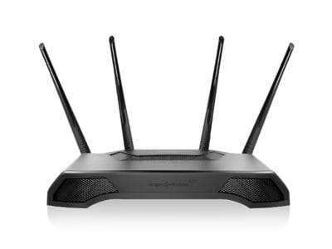
Motivation
State Table
Packet 1
Data decoding
1001 10101 1111
Longer Preamble
1001 10101 ****
10101
1001 10101 ****
Preamble
Data
Signal processing
Header decoding
CRC
1001 10101 ****
1001 10101 ****
Receiver
Common information
(in header)
→State

Slide 18
Motivation
State Table
10101
10101
Packet 2
Recovered state
Data decoding
1001 10101 1111
Longer Preamble
1001 10101 ****
1001 10001 ****
1001 10101 ****
Signal processing
Header decoding
CRC
1001 10001 ****
Receiver

Slide 19
STAPLE
Framework:
We propose a STAteful inter-Packet signaL procEssing (STAPLE) framework.
  It is a generic design for various wireless standards.
Traditional
STAPLE

Slide 20
STAPLE
Framework:
Recover the state
Refine the Channel estimation

Slide 21


State Configuration
Question:
Which fields can constitute the state ?

Slide 22
State Configuration
State for 802.11b:
Entropy
State

Slide 23
State Configuration
802.11 a/g
802.11 ac
802.11 n
802.15.4

Slide 24


Implementation
802.11 b
802.11 a
802.15.4
802.11 g
802.11 n
802.11 ac

Slide 25
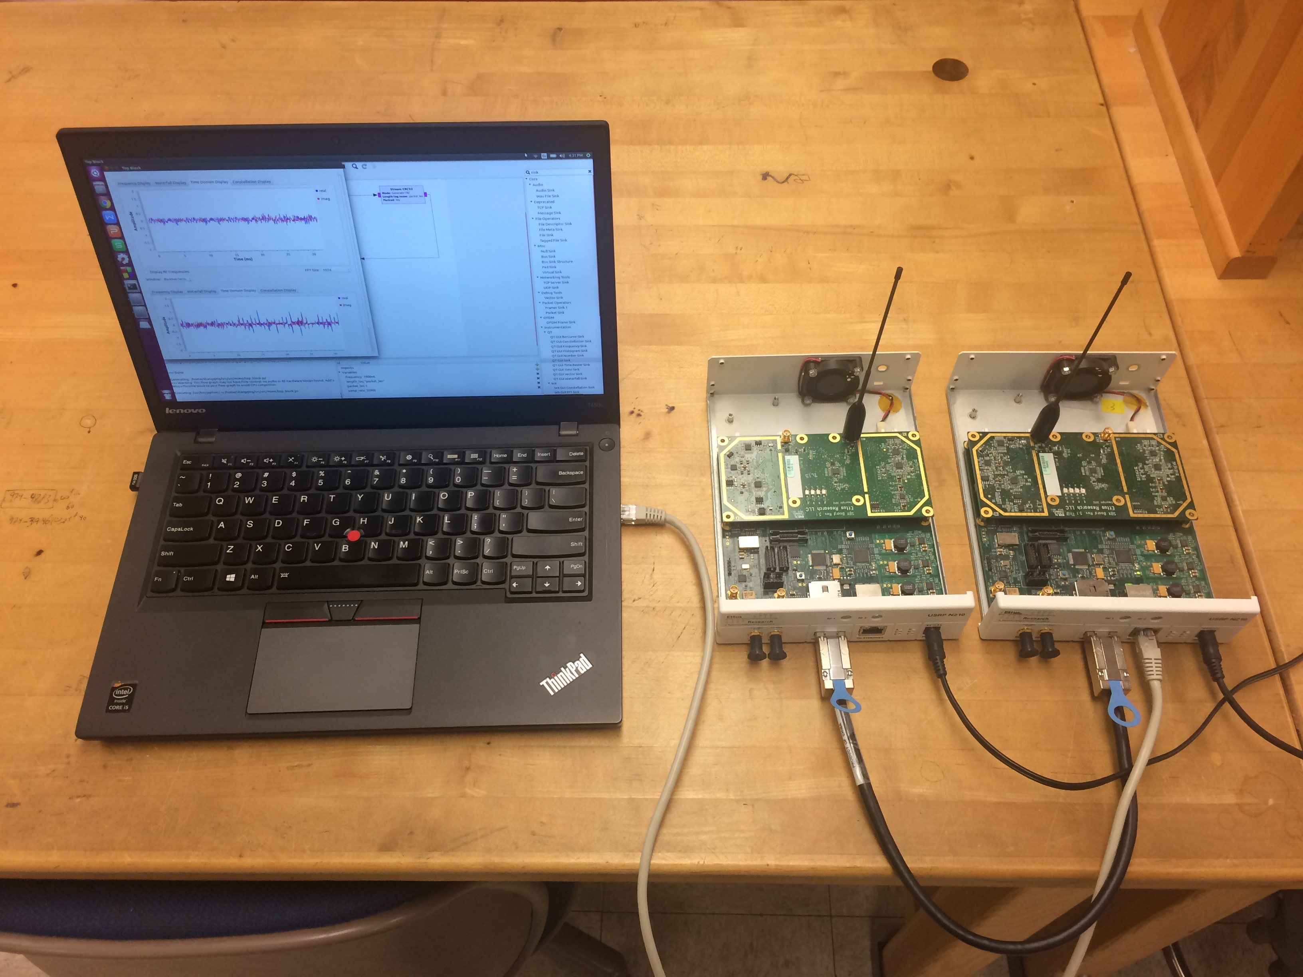
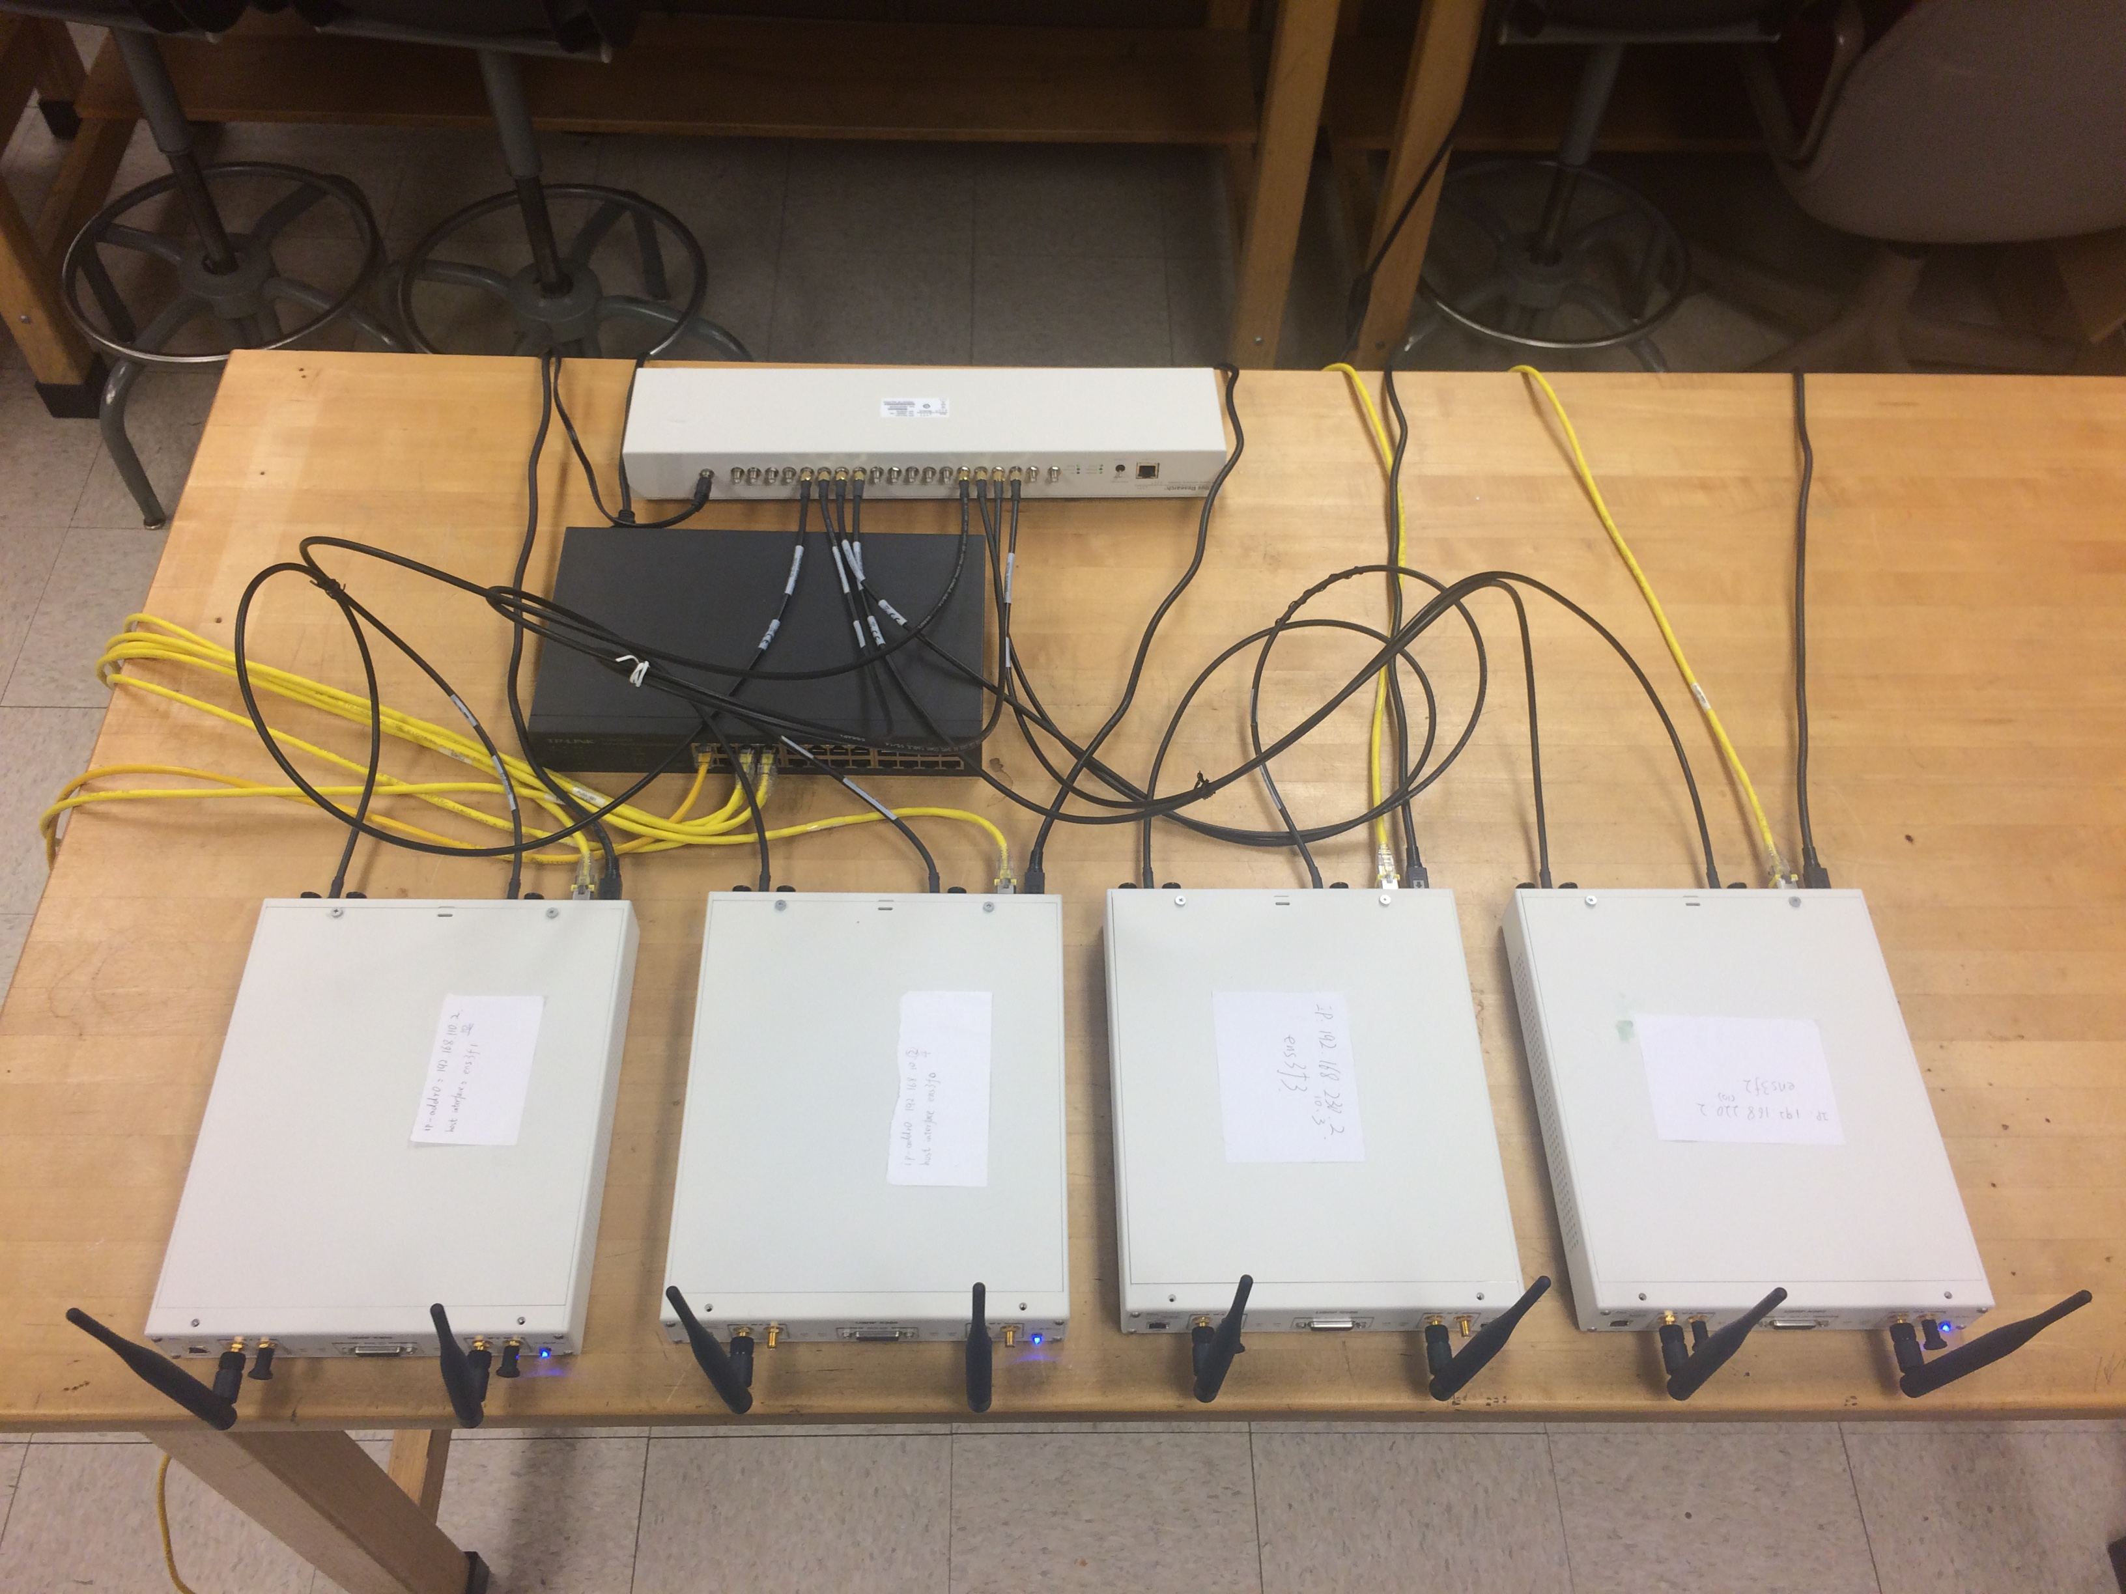
Implementation
Platform:
USRP X300s with CBX daughterboards.
Use OctoClock-G to synchronize multiple USRPs performing MIMO experiments.
2-antenna TX
8-antenna RX

Slide 26
Implementation
Indoor environment:
Metrics:
Packet delivery ratio (PDR)
Performance gain ratio

Slide 27
Single-Link Performance (ac)
Varying locations:
  Place AP at location 1, and station at location 0, 3, 4, 5.
STAPLE is more effective in a severe environment.
Wood door
Location 0
AP
Location 4

Slide 28
Single-Link Performance (ac)
Varying modulation scheme:
  Place AP at location 1, and station at location 7.
  2 * 8 MIMO link
16QAM has a large improvement.
Location 7
AP

Slide 29
Network Performance(ac)
Uplink and downlink:
  Place AP at location 0, and stations at locations 1~6.
  Nodes 4~6 have the larger improvement.
Stations
AP

Slide 30
Network Performance
Different standards:
(Uplink) (Downlink)
  Benefits exist in many standards.

Slide 31
Summary
STAPLE can improve the packet delivery ratio by up to 20% under various conditions.
STAPLE is a generic design which can benefit a wide range of wireless networks.

Slide 32
Q&A
Thank you !

